Slide 1

MovieLens: Spark-based Big Data
Recommendation Analysis
50015627 JIANG Zhuoyang
50016061 GAN Wenxi
50015976 ZHANG Ruiming
50015859 ZHENG Hanwen
HKUST (GZ) INFORMATION HUB: DSAA 5021 Dec.05 2023
Notes:
Good morning everyone, it's a pleasure to share our project with you.
there are three members in our group: Me, GAN Wenxi, ZHANG Ruiming and ZHENG Hanwen,
Our group's theme is MovieLens: Spark-based Big Data Recommendation Analysis

Slide 2
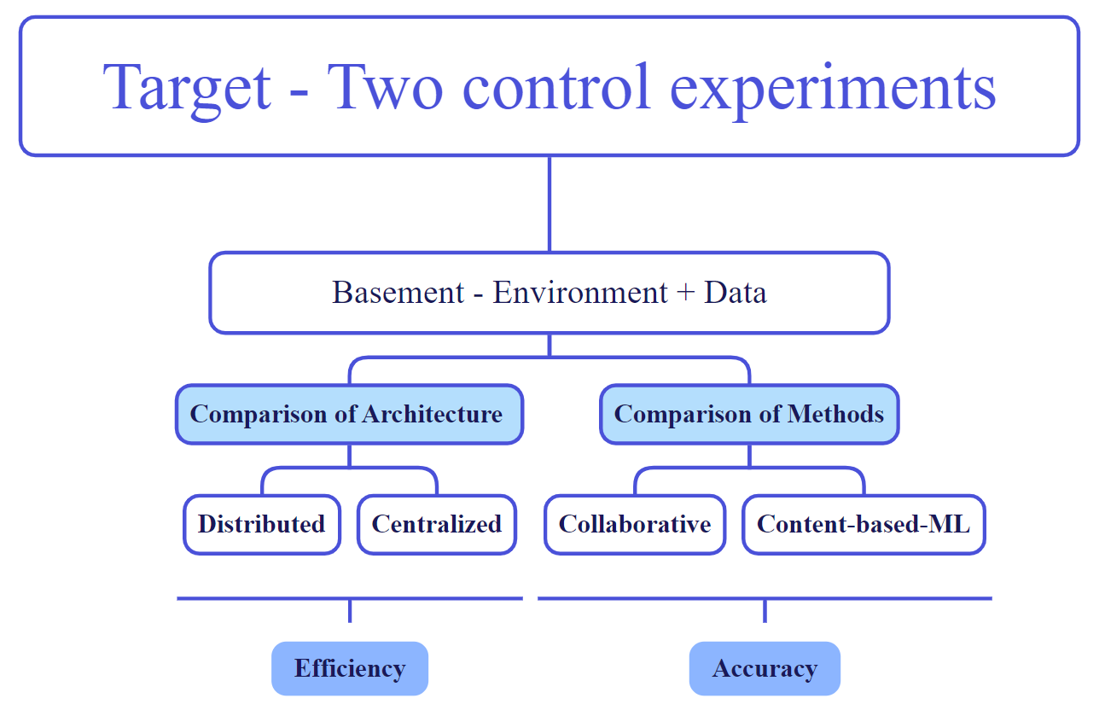

Outline
1. Target - Two control experiments
2. Basement - Environment + Data
3. Architecture - Distributed vs. Centralized
4. Methods - Collaborative vs. Content-ML
5. Result - Efficiency & Accuracy
1
2
3
4
5
Notes:
This Project has 5 parts
I will firstly introduce our target
after construct the Basement
We completed Two control experiments

Slide 3
1. Target - Two control experiments
Notes:
First, let’s begin with the Target

Slide 4
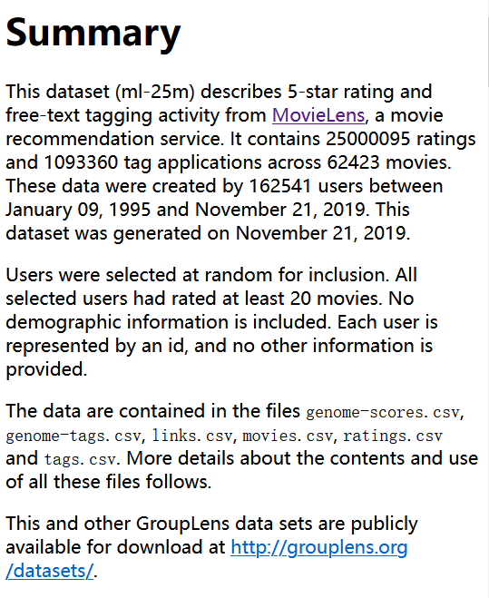
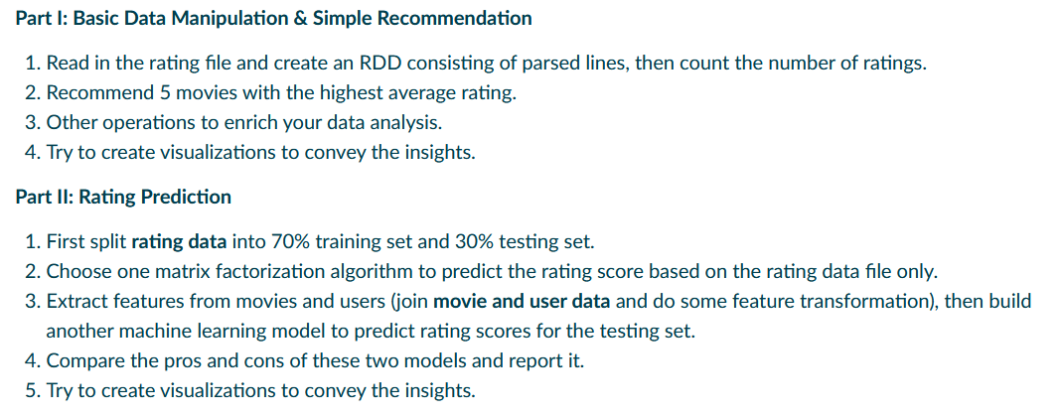
Introduction
MovieLens: Big-Data Recommendation-Analysis with Spark
MovieLens
Big-Data Situation
MovieLens:
It contains 25000095 ratings and 1093360 tag applications
across 62423 movies created by 162541 users
Recommendation-Analysis Task
Requirement
Notes:
After getting this theme，
we find two important point
the first is Big-Data Situation shows in the MovieLens Dataset
Then the Recommendation-Analysis Task from the requirement

Slide 5
Target - Two control experiments
MovieLens: Big-Data Recommendation-Analysis with Spark
Big-Data Situation
Recommendation-Analysis Task
How to improve operational efficiency?
How to improve Analysis accuracy?
Architecture Selection (Comparison 1)
Method Selection (Comparison 2)
Distributed vs. Centralized
Collaborative vs. Content-based-ML
Control Experiments - 1
Control Experiments - 2
Control method unchanged
Investigate architecture about efficiency
Control Dataset/Architecture unchanged
Investigate method about accuracy
Notes:
For Big-Data Situation，we ask：
So that we find the first comparision:
which generate the
For Recommendation-Analysis Task，we ask：
So that we find the other comparision:
which generate the

Slide 6
Target - Two control experiments
MovieLens: Big-Data Recommendation-Analysis with Spark
Big-Data Situation
Recommendation-Analysis Task
How to improve operational efficiency?
How to improve Analysis accuracy?
Architecture Selection
Method Selection
Distributed vs. Centralized
Collaborative vs. Content-based-ML
SPARK ENGINE: Simultaneously meeting the requirements of
Building the underlying framework and Encapsulating the upper-level algorithms
Control Experiments - 1
Control Experiments - 2
Notes:
Both Experiment can be run on the SPARK ENGINE,
because it Simultaneously meeting the requirements of Building the underlying framework and Encapsulating the upper-level algorithms

Slide 7
Target - Two control experiments
MovieLens: Big-Data Recommendation-Analysis with Spark
Big-Data Situation
Recommendation-Analysis Task
How to improve operational efficiency?
How to improve Analysis accuracy?
Architecture Selection
Method Selection
Distributed vs. Centralized
Collaborative vs. Content-based-ML
SPARK ENGINE: Simultaneously meeting the requirements of
Building the underlying framework and Encapsulating the upper-level algorithms
Control Experiments - 1
Control Experiments - 2
Cluster-mode vs. Local-mode
ALS vs. Feature Engineering ML
Notes:
So the experiments can be further set as:
Cluster-mode vs. Local-mode
ALS vs. Feature Engineering ML

Slide 8
From Target to Pipeline
1
MovieLens: Big-Data Recommendation-Analysis with Spark
2
3
4
5
Notes:
So that This Theme is oganized as this pipeline from our target

Slide 9
2. Basement - Environment + Data
Notes:
Then Let’s construct Basement for Environment & Data

Slide 10
Try to know why before implement how!
Notes:
Then Let’s construct Basement for Environment & Data

Slide 11
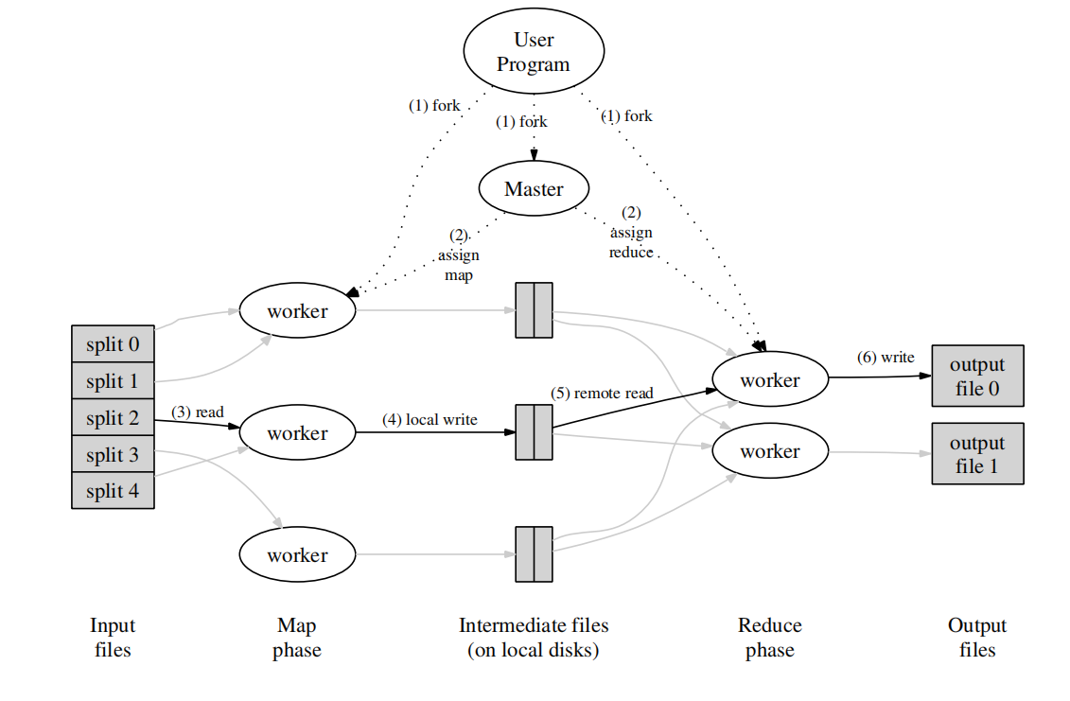
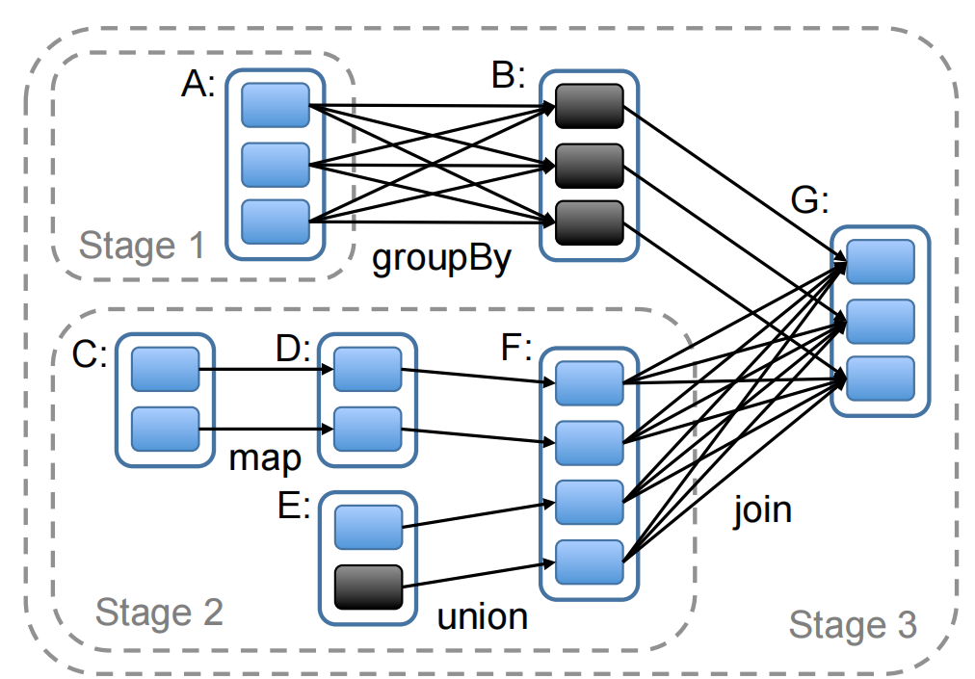
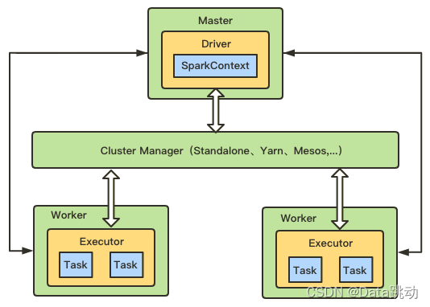
2.1 Environment Choice- Architecture
Hadoop MapReduce
Spark
Input
Domain
Map
Domain
Medium
Domain
Reduce
Domain
Output Domain
Data-Split
Map
Operation
Disk
Remote read
Data-Store
Task Domain
Program-folk
Local write
Manage
Reduce
Operation
Program-end
read
instruct
assign map
Master
Local-write instruct
assign reduce
Control Domain
Master
write
instruct
Remote-read instruct
Execute Domain
(k1,v1)_1
map₁(k1,v1)
list(k2,v2)_1
redu₁(k2,list(v2))
list(v2)_1
Spark inherits advantages from Hadoop MapReduce
Spark enables faster computational processing
In Hadoop, intermediate data stored in HDFS,
In Spark, processes can retain intermediate data
(k1,v1)_2
map₂(k1,v1)
list(k2,v2)_2
redu₂(k2,list(v2))
list(v2)_2
Workers
K-V process
...
...
...
...
...
(k1,v1)_a
map_{b}(k1,v1)
list(k2,v2)_b
redu_{c}(k2,list(v2))
list(v2)_c
Memory Domain
GFS
M-Worker
->Local-Disk
Disks
Some-Disk
->R-Worker
GFS
Basic efficiency rules
Notes:
We prefer Spark as Our base architecture than Hadoop MapReduce

Slide 12
2.1 Environment Choice - Data Structure
Core Abstractions of SPARK: [Two major virtualizations - Processing Virtualization + Storage Virtualization]
1. Distributed(Processing Virtualization):
Element Collection is multiple-partitioned allowing processed in parallel.
2. Resilient(Storage Virtualization):
By default, RDD data resides in memory, when memory insufficient, automatically to disk.
RDD: Resilient Distributed Datase
DataFrame: Higher-level abstraction upon RDD
Provides an abstract view and basic implementation
Offers optimized query plans and columnar storage
for enhanced efficiency
Lower-level: Fundamental rule and core concept
Higher-level: Schema Metadata upon RDD
For Flexible data handling
Also for Structured data handling
Ideal for more intricate & flexible data processing
Ideal for structured data & high-performance computing
Notes:
Essentially We utilized the SPARK’s Two major virtualizations - Processing Virtualization + Storage Virtualization
And base on this our Data Structure is DataFrame which based on RDD
and have better performance on Structured data handling

Slide 13
2.1 Environment Choice - ML Tool
SKLearn
Spark MLLib
The computing engine uses Spark
which means that all computing processes are implemented in a distributed manner
Focuses on traditional, single-machine ML
Focuses on distributed, scalable ML for Big-data
Python-centric, well-established in Py-ML community
Tight integration with Spark ecosystem
Suitable for smaller datasets and research
Large-scale data processing and analysis
Big roblems
decomposed
into many
Relatively Independent
Sub Problems
processed in parallel
Result Convergence
big problems have also been solved
Divide-Conque-Merge
RDD: Resilient Distributed Datase
DataFrame: Higher-level abstraction upon RDD
Spark MLLib: based mainly on RDD
Spark ML: Based mainly on DataFrame

Slide 14
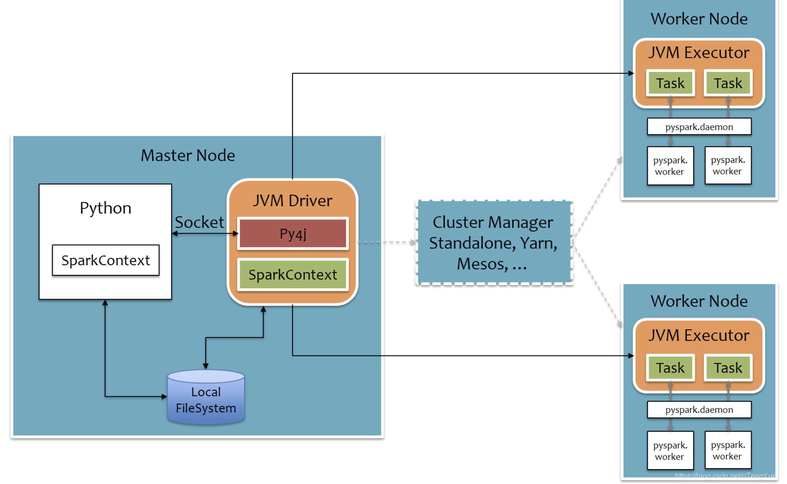
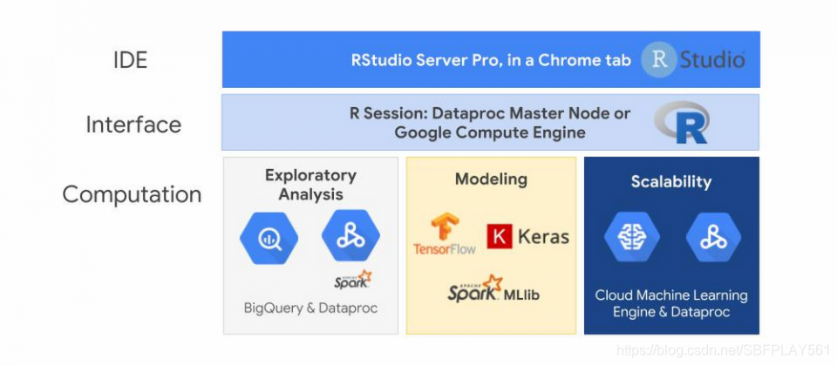
2.1 Environment - Dataproc+PySpark
Why PySpark?
Why Cloud Dataproc?
PySpark 3.0.0 has seen major updates in the MLlib package making it easier to work with in comparison to versions 2.x.
PySpark is pre-installed.
Easy to spin up a Spark cluster.
Simple to add worker nodes after a cluster has been instantiated.
Autoscaling policies to add worker nodes automatically.
Notes:
Then We use Dataproc with PySpark because these reasons

Slide 15
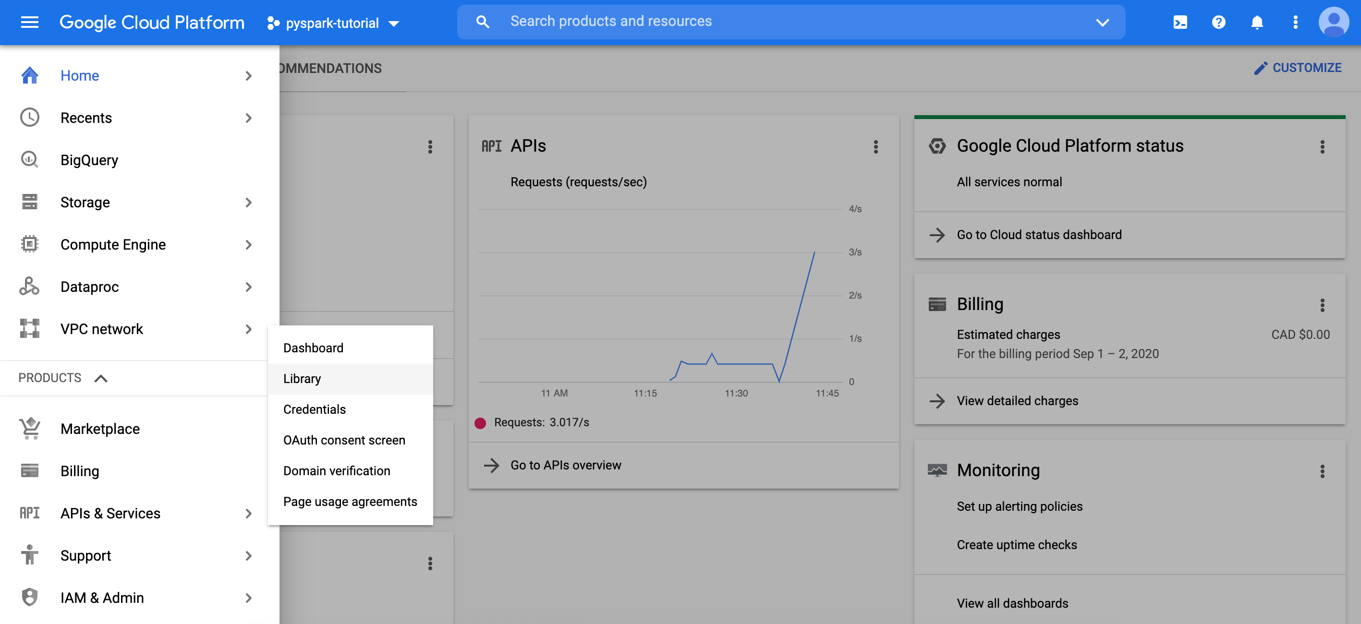
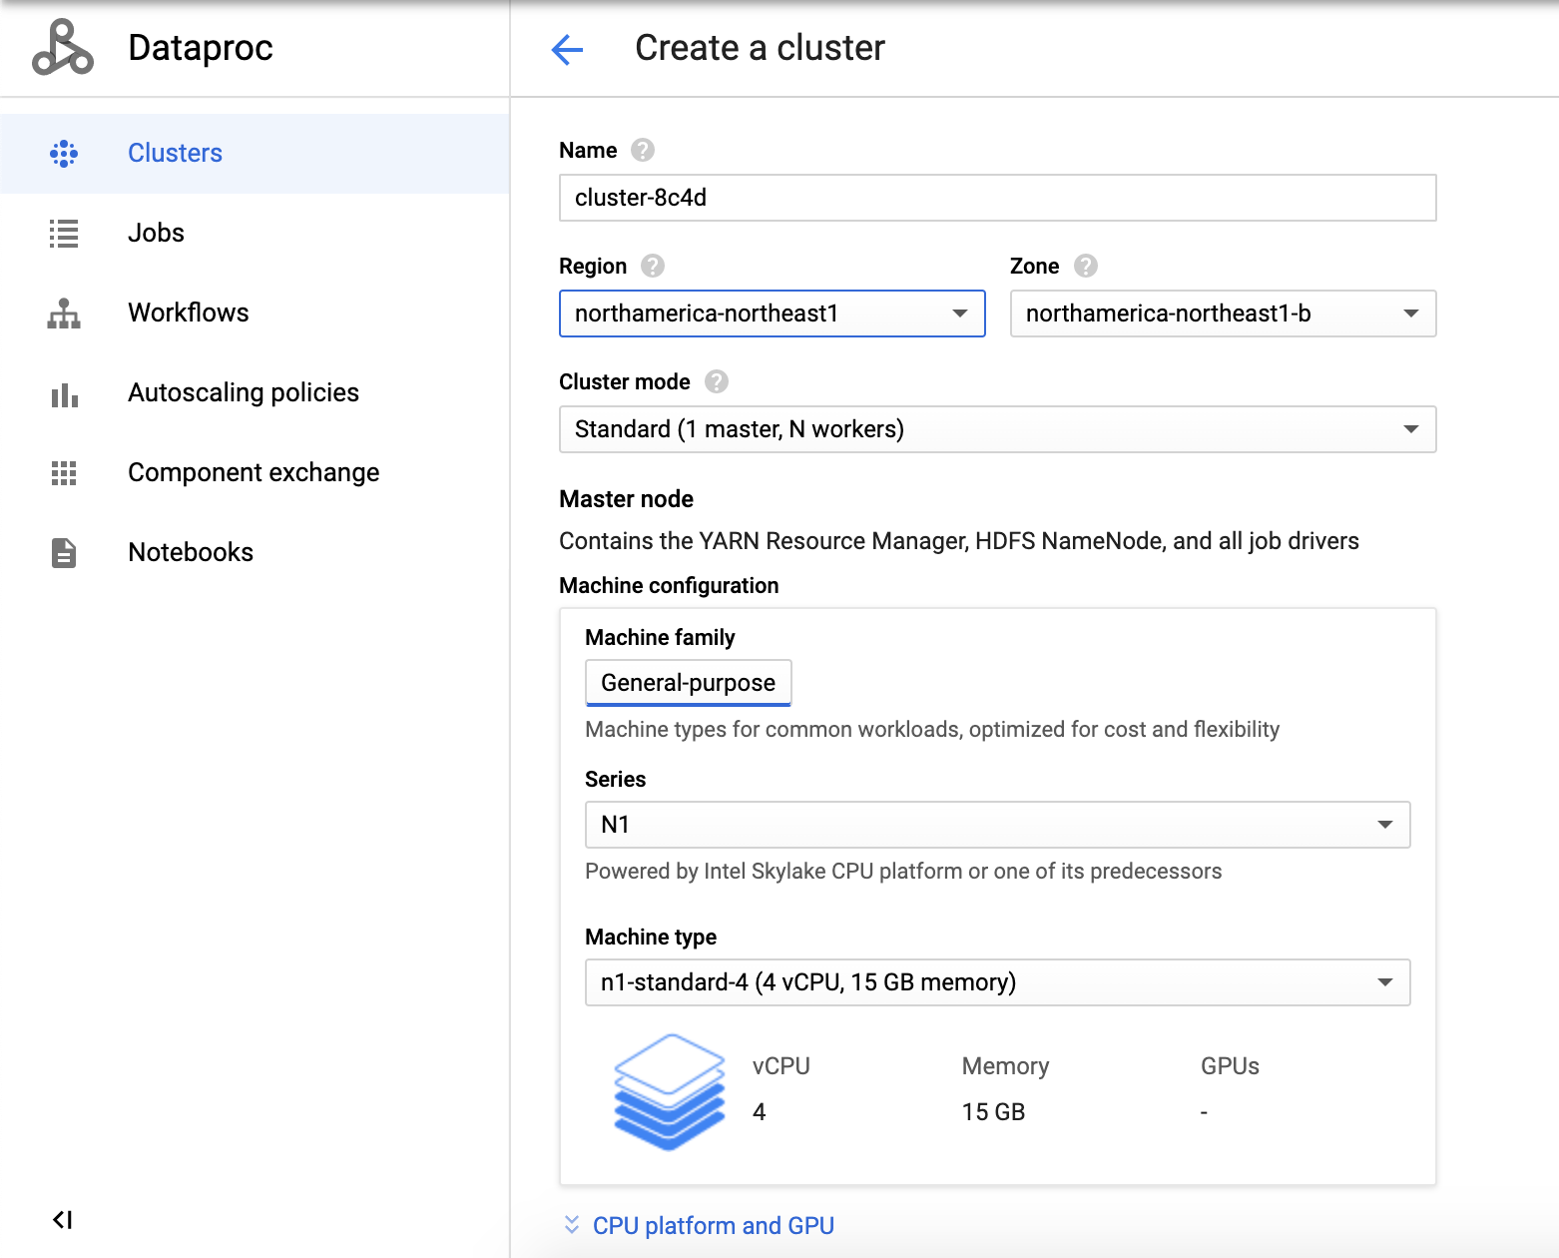
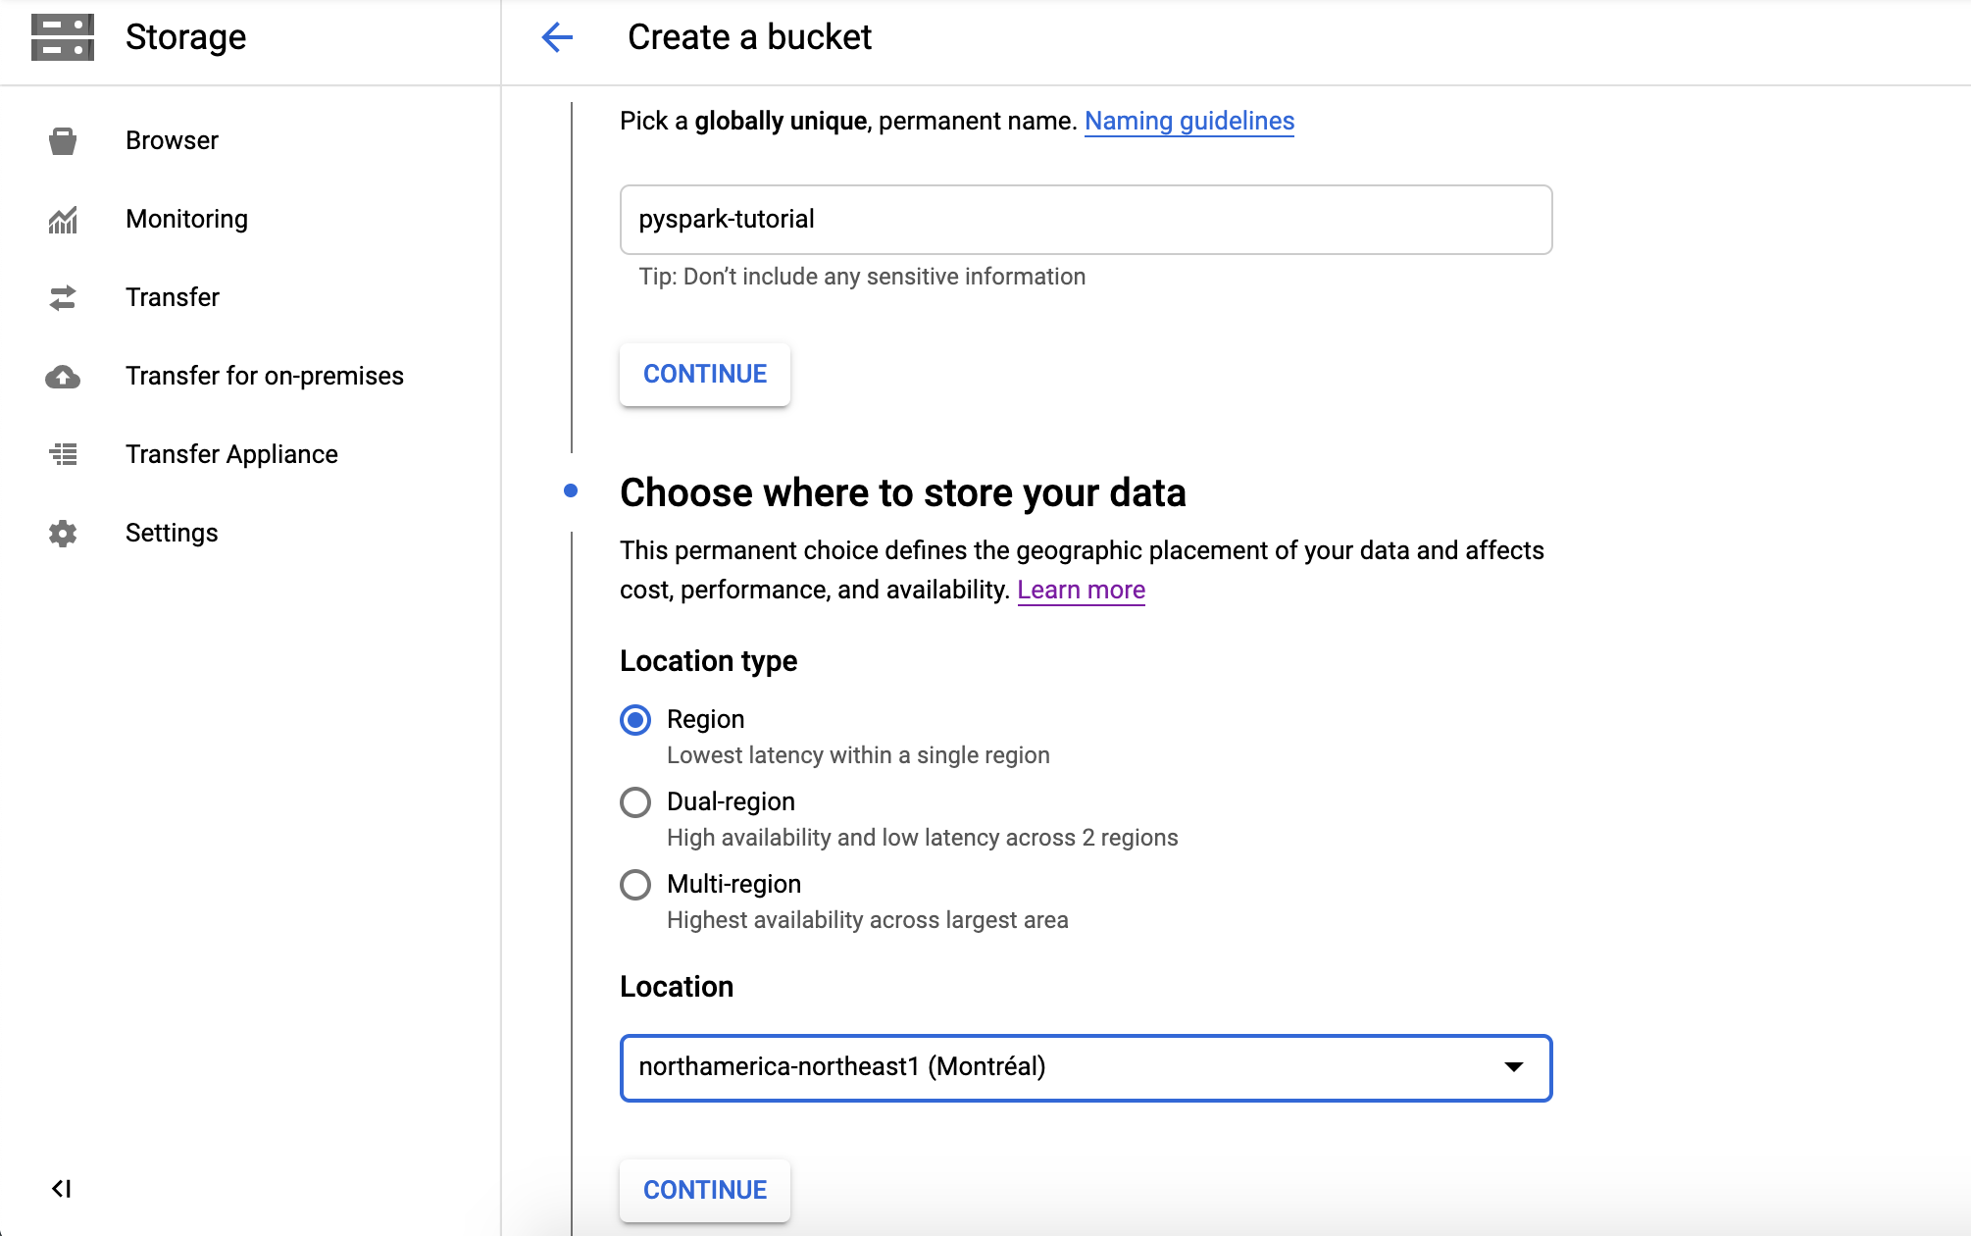
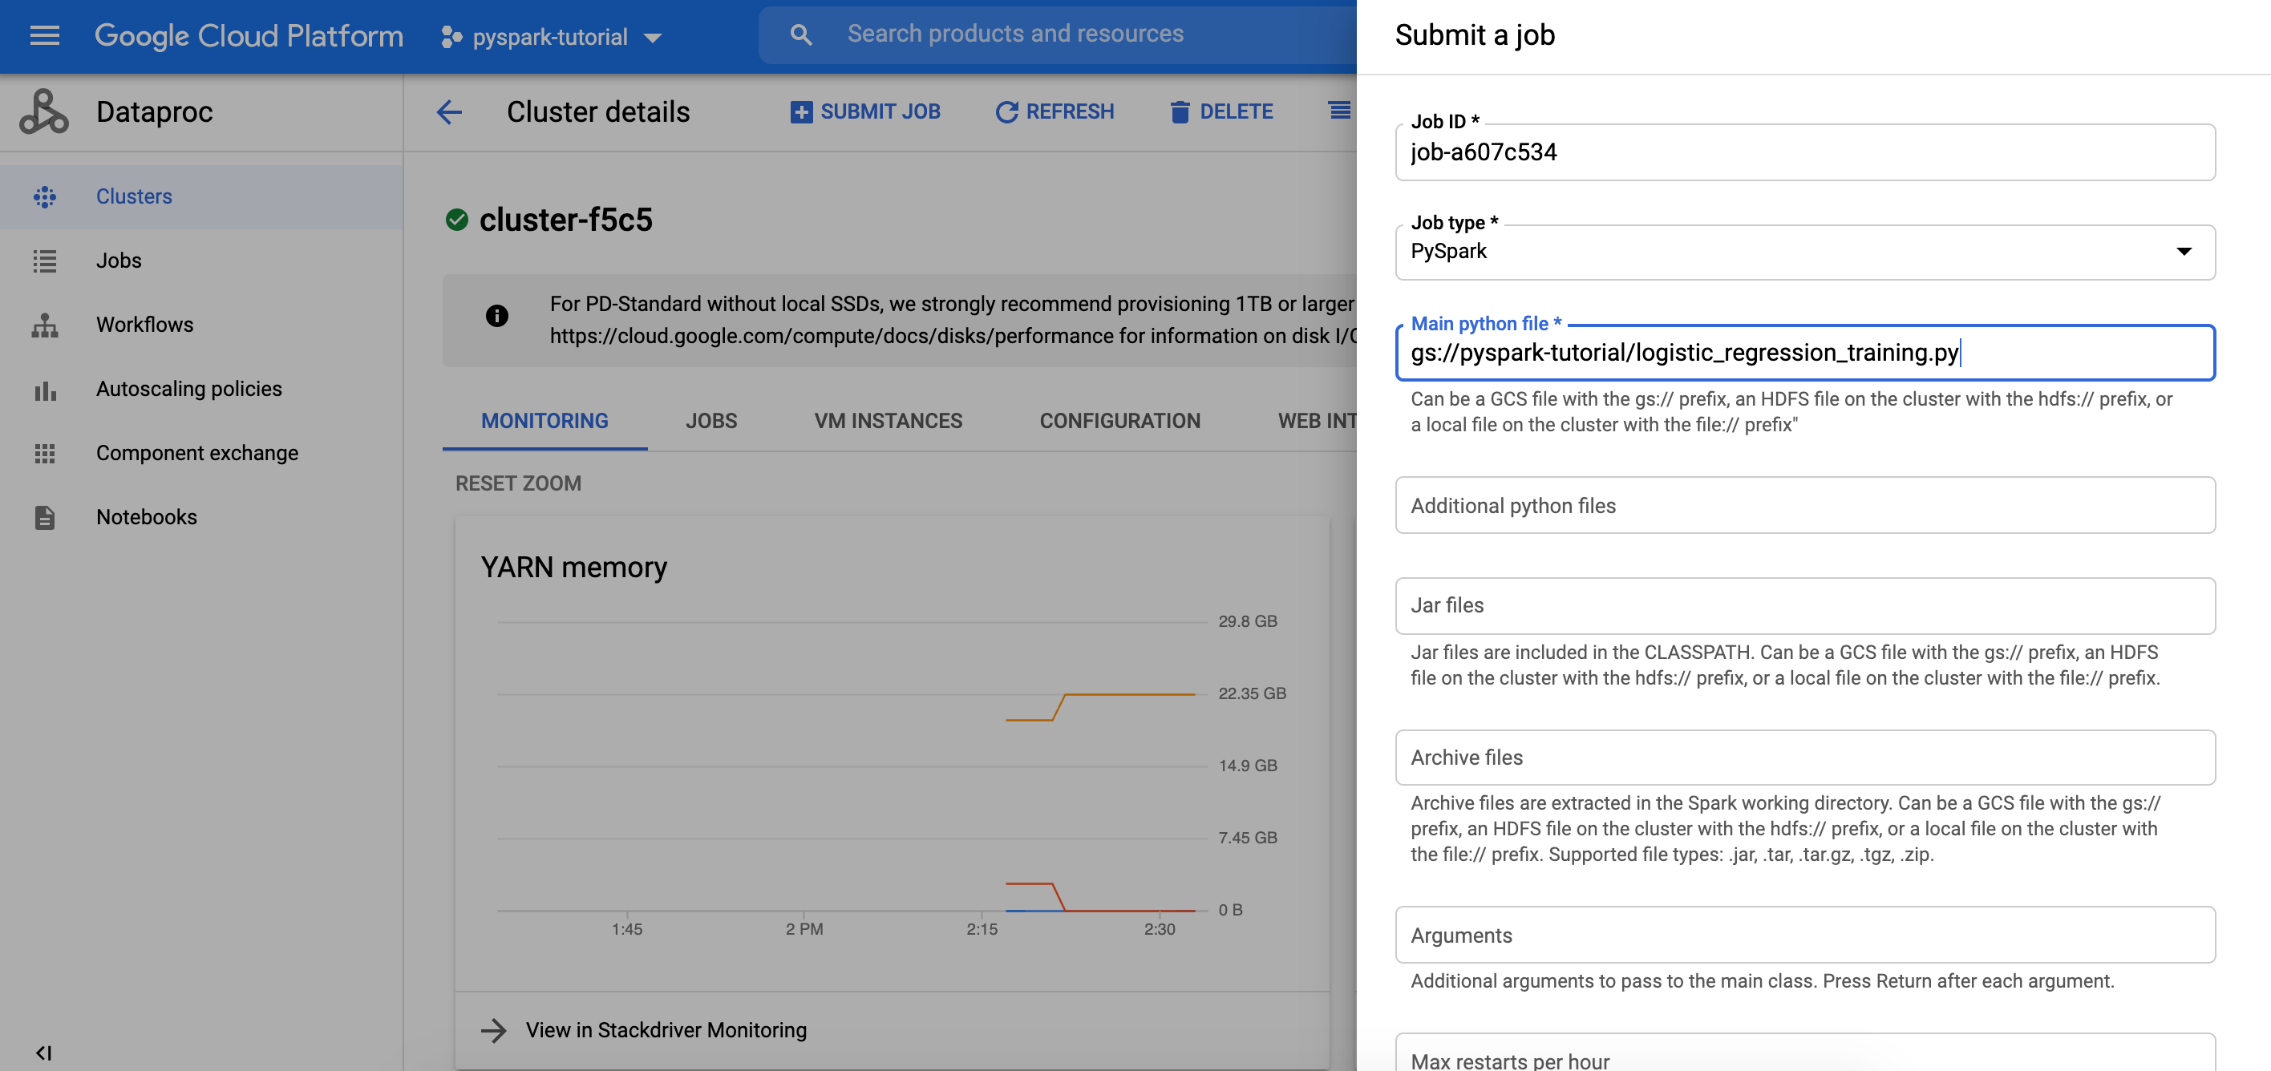
2.1 Environment - Dataproc+PySpark
1. Cloud Dataproc Setup
2. Create A Dataproc Cluster
3. Cloud Storage Setup
4. Submit a Spark Job
Notes:
this is the steps to set the environment on Dataproc
you can see that, it’s effective

Slide 16
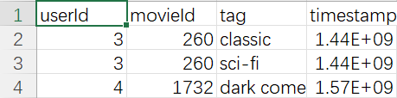
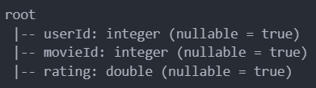
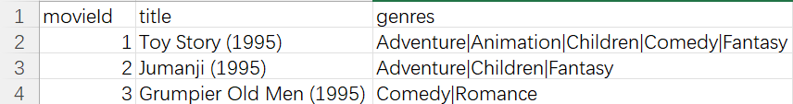
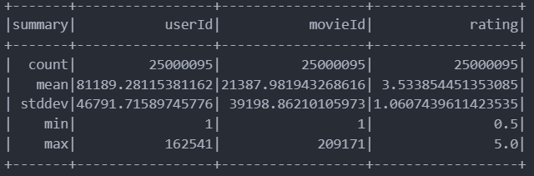
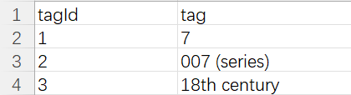
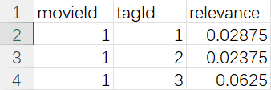
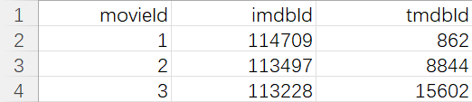
2.2 Data - Data Load
Basic Data Series: ratings.csv
Mainly-dependent information: movies.csv
Auxiliary information: tags.csv; links.csv;
genome-tags.csv;
genome-scores.csv
tags.csv
movies.csv
genome-tags.csv
genome-scores.csv
ratings.csv
links.csv
Notes:
The we build the data basement
There are 3 kind of input data,
we basically use ratings.csv
and mainly depend on movies.csv
with others as Auxiliary information

Slide 17
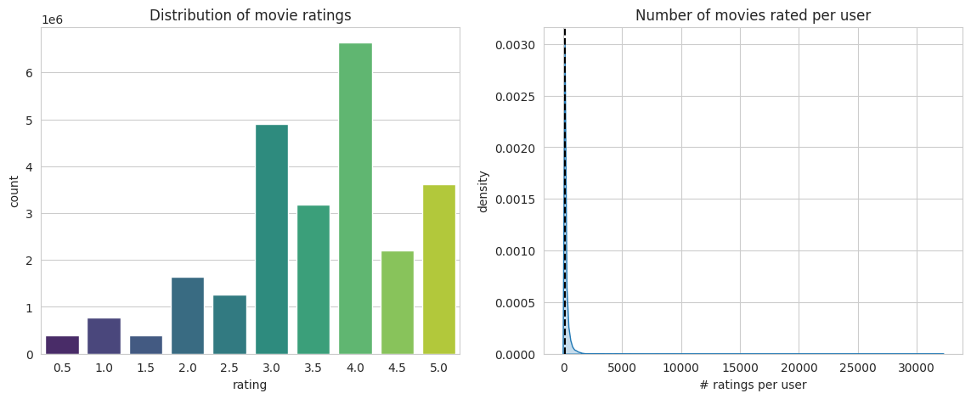
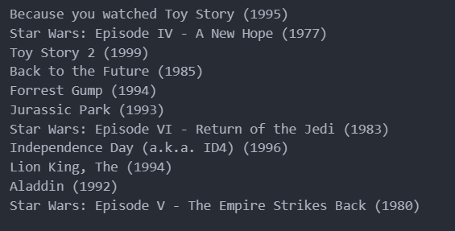
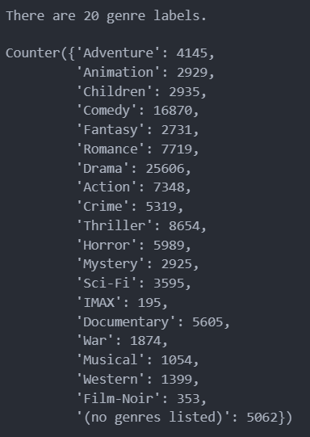
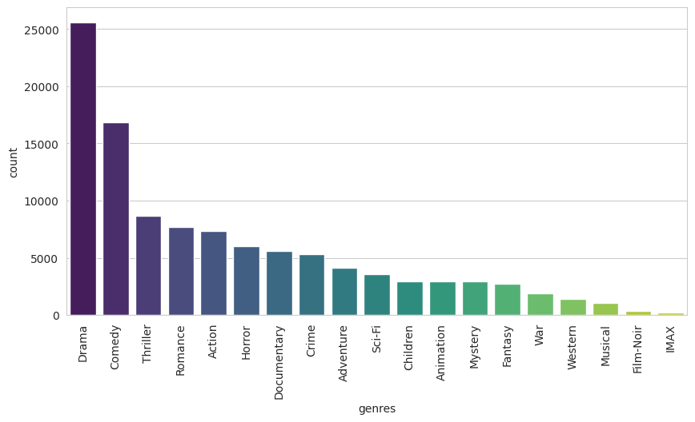
2.2 Data - EDA and Preprocessing
Basic Data Series: ratings.csv
Mainly-dependent information: movies.csv
Auxiliary information: tags.csv; links.csv;
genome-tags.csv;
genome-scores.csv
Title include Movies’ Age Information
Genre has a certain amount of variation
in the average rating.
Notes:
After EDA and Preprocessing we get a knowledge that
Title include Movies’ Age Information
Genre has a certain amount of variation in the average rating.

Slide 18
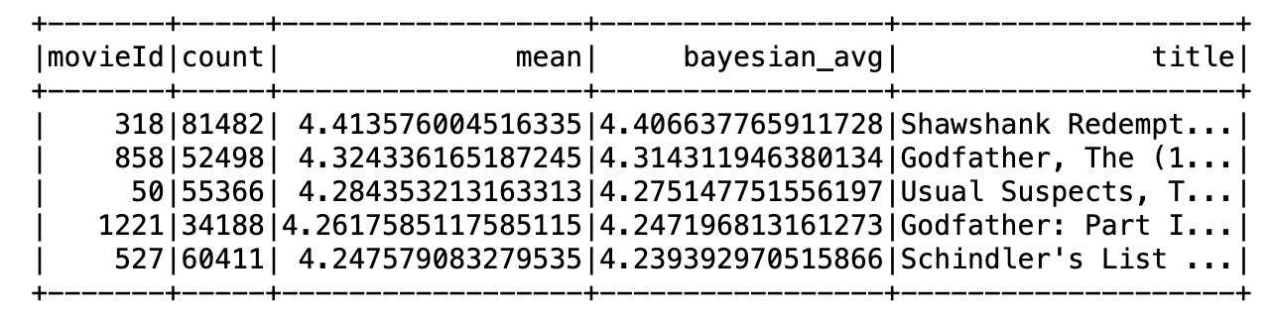
2.2 Data - Top 5
1. Calculate movie statistics information
2. Calculate the global average
3. Applying Bayesian averaging
4. Merge movie information
5. Sort and display results
Notes:
After EDA and Preprocessing we get a knowledge that
Title include Movies’ Age Information
Genre has a certain amount of variation in the average rating.

Slide 19
From Target to Pipeline
1
MovieLens: Big-Data Recommendation-Analysis with Spark
2
3
4
5
Notes:
Then we will do the control experiment on the basement

Slide 20
3. Architecture - Distributed vs. Centralized
Notes:
The first is for comparision of architecture

Slide 21
3. Control Experiments on Architecture
Big-Data Situation
Using the ALS algorithm as the controlled variable
to test operational efficiency
How to improve operational efficiency?
Architecture Selection
Distributed vs. Centralized
Create two Spark sessions on Cloud Dataproc
by setting Cluster mode and Local mode separately
Control Experiments - 1
Control method unchanged
Investigate architecture about efficiency
In both cases, calculate the training time separately
to verify whether distributed computing is faster than centralized
Cluster-mode vs. Local-mode
Notes:
Using the ALS algorithm as the controlled variable
to test operational efficiency
Create two Spark sessions on Cloud Dataproc
by setting Cluster mode and Local mode separately
In both cases, calculate the training time separately
to verify whether distributed computing is faster than centralized

Slide 22
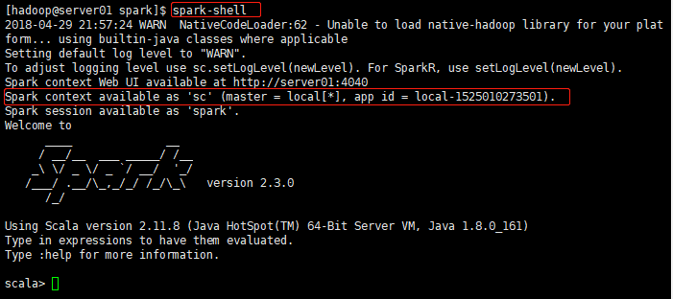
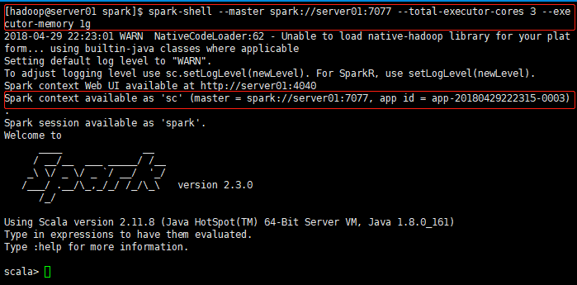
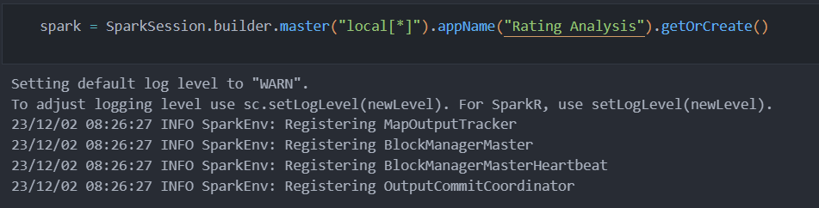
Distributed vs. Centralized
1. Local mode does not run on the cluster, but on the current executing machine
2. Local mode tasks will not be displayed on spark web pages
3. Local mode uses threads to simulate worker processes in the cluster
Local-mode
Cluster-mode
Local-mode spark shell
Cluster-mode spark shell
In Cloud Dataproc: use “local[*]” to build the session for local-mode
Notes:
Local mode here uses threads to simulate worker processes in the cluster

Slide 23
4. Methods - Collaborative vs. Content-based-ML
Notes:
Then we do a contrled experiment on Methods

Slide 24
4. Control Experiments on Methods
Recommendation-Analysis Task
Using the same framework to complete the same regression tasks for predicting on the same Training-test set.
How to improve recommendation accuracy?
Method Selection
Collaborative vs. Content-ML
Adopt the ALS algorithm based on collaborative filtering matrix factorization and the linear regression algorithm based on machine learning feature engineering, respectively
Control Experiments - 2
Control Dataset/Architecture unchanged
Investigate method about accuracy
Learn the calling methods of two types of algorithms in the PySpark framework, and calculate the testing accuracy of both algorithms
ALS vs. Feature Engineering ML
Notes:
After Using the same framework to complete the same regression tasks for predicting on the same Training-test set.
we Adopt the ALS algorithm based on collaborative filtering matrix factorization and the linear regression algorithm based on machine learning feature engineering, respectively
and Learn the calling methods of two types of algorithms in the PySpark framework, and calculate the testing accuracy of both algorithms

Slide 25
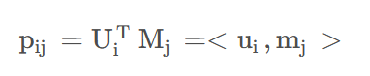
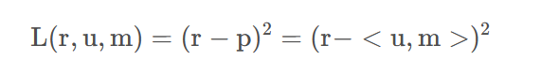
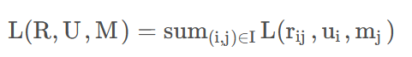
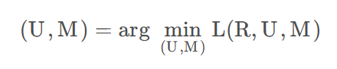
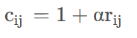
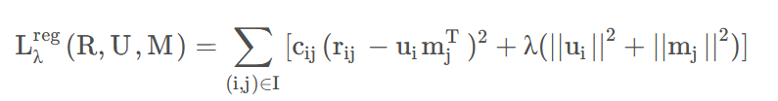
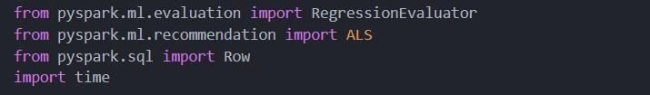
4.1 Collaborative Method: ALS
Model
Loss Function
u_{i} & m_{j} latent features
Parameter
Hyperparameter
Hyperparameter
implicit rating weight
Rating Matrix: P_{a*b}
User Matrix: U_{a*k}
Movie Matrix: M_{k*b}
L2 regularization
Attempt to directly construct latent variables for users and items
Implementation
Notes:
ALS is a very exquisite algorithm for recommend analysis problem
because it Attempt to directly construct latent variables for users and items

Slide 26
4.1 Collaborative Method: ALS
Model
Loss Function
u_{i} & m_{j} latent features
Parameter
Hyperparameter
Hyperparameter
implicit rating weight
Rating Matrix: P_{a*b}
User Matrix: U_{a*k}
Movie Matrix: M_{k*b}
L2 regularization
Attempt to directly construct latent variables for users and items
Implementation
Notes:
ALS is a very exquisite algorithm for recommend analysis problem
because it Attempt to directly construct latent variables for users and items

Slide 27
4.2 Content-based-ML Method: Abstract
Input Domain
Function Domain
Output Domain
Raw data about [User,Movies,rating] pairs
Regression Prediction
For [UserX,MoviesY] pair：
UserX’s rating on MoviesY
Task Domain
1. What is Feature?
3. Model Selection
6. Prediction
Data Reconstruct
Data-Adaptability
Model Application
Data Preprocessing
Consumption
Result Visualization
Model
Domain
2. Feature Engineering
4. Model Training
5. Model Evaluation
Feature Generation
Trainset and Val-set
Accuracy
Feature Selection
Model Tuning
[User-Feature,Movies-Feature]
Prediction-ML-Model
10 class = {0.5, 1.0, 1.5, ..., 5.0}

Slide 28
4.2 Content-ML Method: Feature Engineering
Attribute Feature: What kind of subject/object is it?
Behavior: Rating(User,Movie)
Feature
Behavior Feature: What phenomenon does the behavior of the subject towards the object imply?
User-Based Feature
Movies-Based Feature
User’s Attribute Feature: Vacancy
Movie’s Attribute Feature: Title/Genre/Age
Behavior Feature: Rating_value/num_of_UserID Behavior Feature: Rating_value/num_of_MovieID
Use UserID
Search Corresponding
User-Based Feature
Use MovieID
Search Corresponding
Movies-Based Feature
rating.csv: [UserID, MovieID] Pairs
[User-Based Feature, Movies-Based Feature] Vactors

Slide 29
4.2 Content-ML Method: Feature Engineering
Information Data: [movies.csv]; tags.csv; links.csv; genome-tags.csv; genome-scores.csv
User-Based Feature
Movies-Based Feature
User’s Attribute Feature: Vacancy
Movie’s Attribute Feature: Title/Genre/Age
Behavior Feature: Rating_value_characteristic,Rating_num_characteristic
Use UserID
Search Corresponding
User-Based Feature
Use MovieID
Search Corresponding
Movies-Based Feature
Basic Data: rating.csv--[UserID, MovieID] Pairs
[User-Based Feature, Movies-Based Feature] Vactors
['user_avg_rating', 'user_avg_rating_squared', 'user_min_rating', 'user_max_rating', 'user_median_rating', 'user_rating_range', 'user_rating_std','user_num_movies_rated', 'user_num_movies_rated_squared',
'title', 'Adventure', 'Animation', 'Children', 'Comedy', 'Fantasy', 'Romance','Drama', 'Action', 'Crime', 'Thriller', 'Horror', 'Mystery', 'Sci-Fi','IMAX', 'Documentary', 'War', 'Musical', 'Western', 'Film-Noir','1870.0', '1880.0', '1890.0', '1900.0', '1910.0', '1920.0', '1930.0', '1940.0', '1950.0', '1960.0', '1970.0', '1980.0', '1990.0', '2000.0', '2010.0']
...

Slide 30
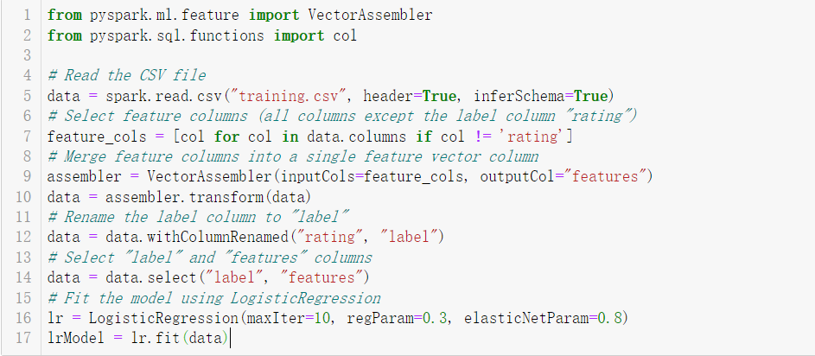
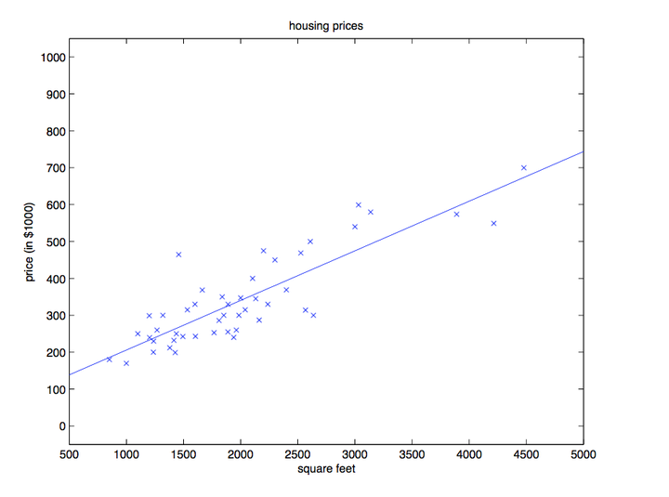
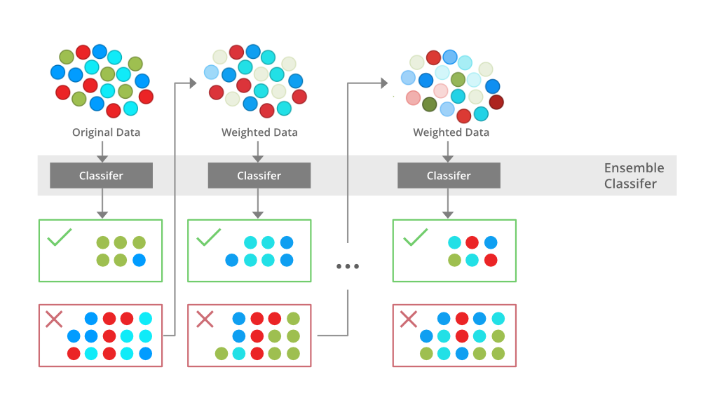
4.2 Content-based-ML Method: Model
Model Selection
Model Training
Linear Regression：
• Predict as regression
• Poor performance: Simple & Naive
• Time consuming, impossible to add other features
DataFrame
Transformer
Gradient-boosted tree regression:
• Predict as regresion
• Leaf-wise Tree Growth: lower training loss, faster
• Prevent overfitting: max_depth, num_leaves, min_data_in_leaf, early_stopping
• Boosting: feature_fraction, bagging_fraction
Estimator
DataFrame:
Fundamental data structure stores objects in a Spark MLlib-specific Vector type.
Transformer(transform()):
Transforming data in a DataFrame,
Used for [feature transformation] and [applying trained models]
Convert feature datasets into data with predicted results.
Estimator(fit()) (Pipeline; Parameter)

Slide 31
5. Result - Efficiency & Accuracy
Notes:
First, let’s begin with the problem

Slide 32
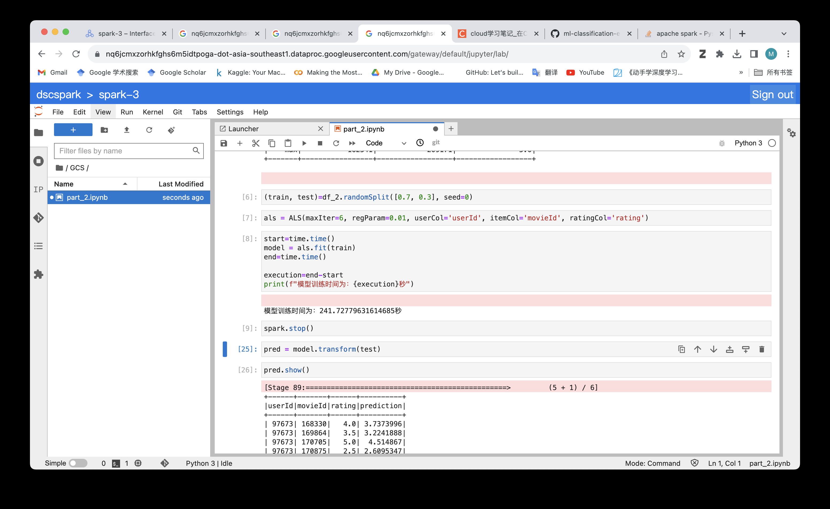
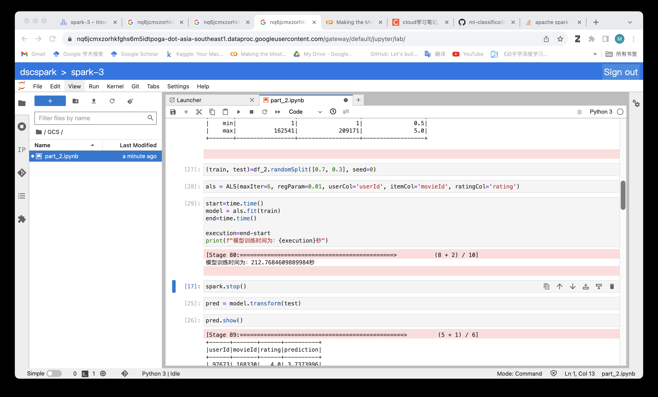
5.1 Efficiency
ALS Method with Local-mode and Cluster-mode
Cluster-mode 29s faster
Big-Data Situation
How to improve operational efficiency?
Architecture Selection
Distributed vs. Centralized
Local-mode
Control Experiments - 1
Control method unchanged
Investigate architecture about efficiency
Cluster-mode vs. Local-mode
Cluster-mode

Slide 33
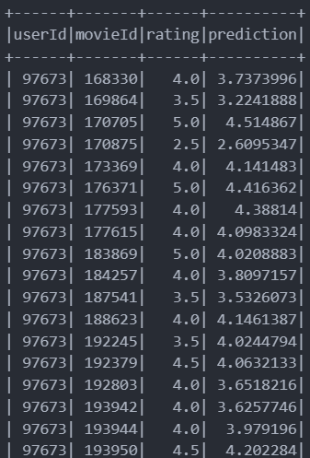
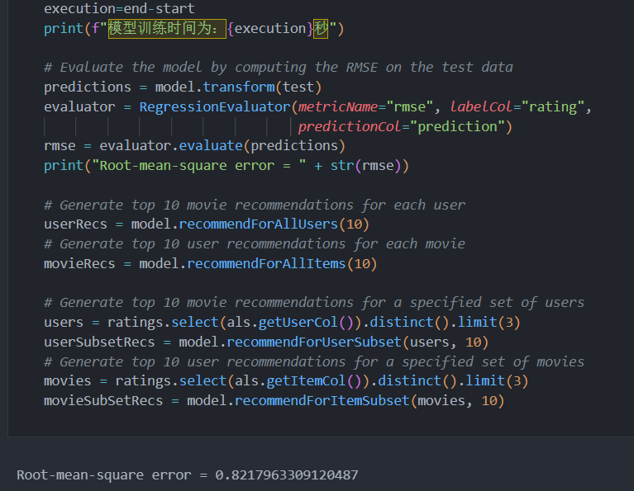
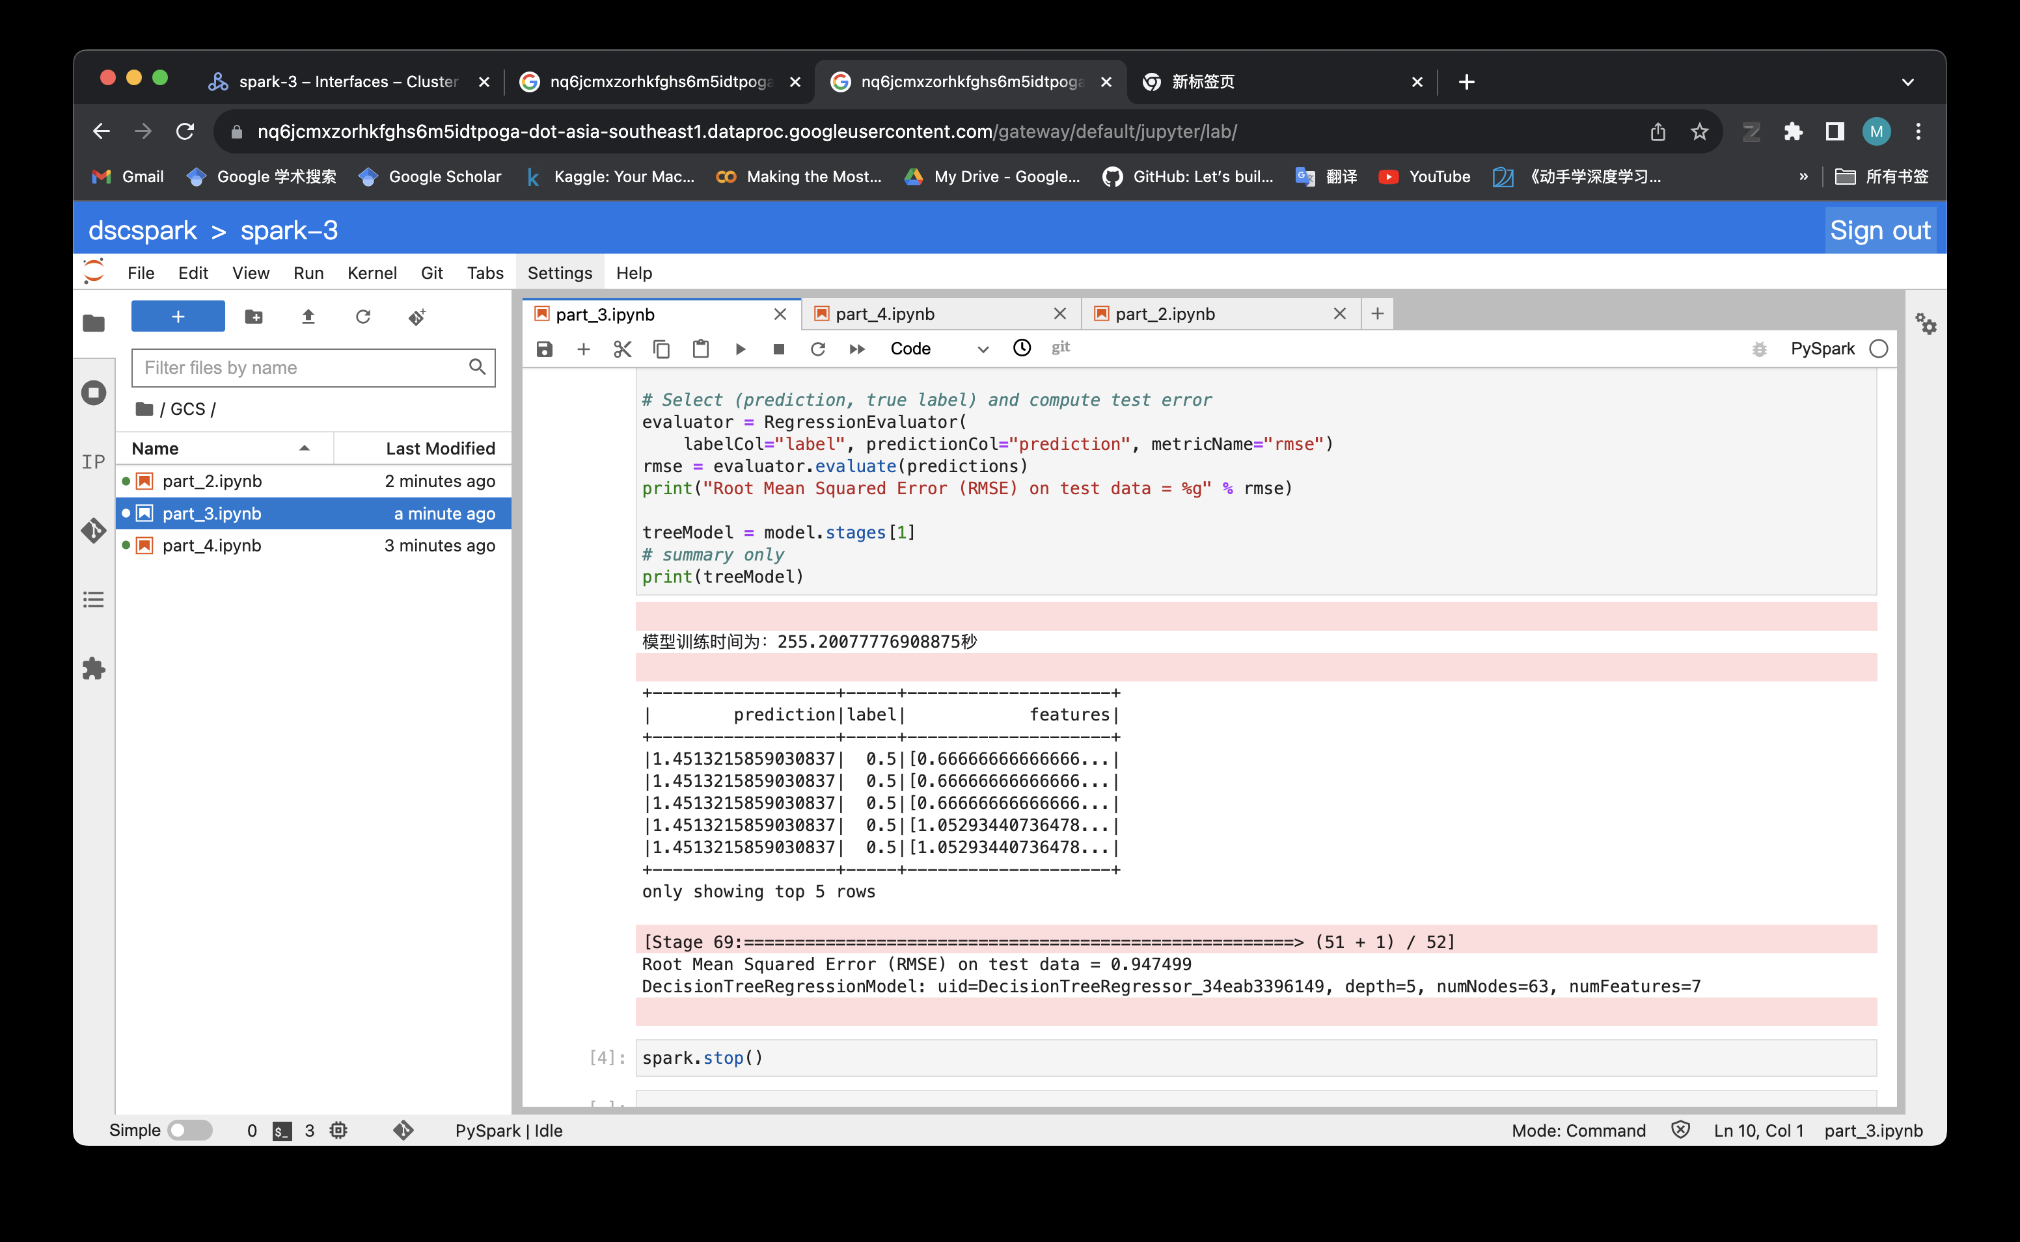
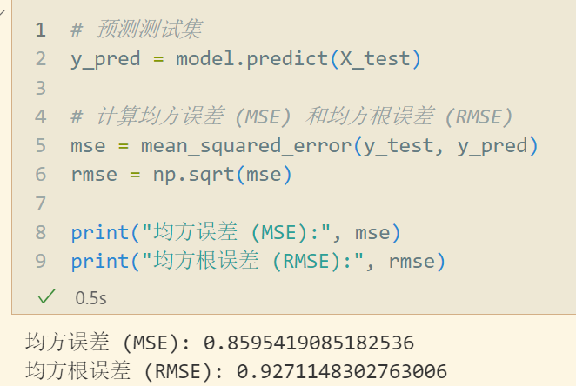
5.2 Accuracy
ALS and Feature Engineering ML on the same data
ALS
Recommendation-Analysis Task
How to improve recommendation accuracy?
Method Selection
Collaborative vs. Content-ML
Root-mean-square error = 0.8217963309120487
Control Experiments - 2
Control Dataset/Architecture unchanged
Investigate method about accuracy
Feature Engineering
ML
(Decision
Tree)
SkLearn :LinearRegression
ALS vs. Feature Engineering ML
ML:Decision Tree
Root-mean-square error = 0.947499

Slide 34
5.2 Accuracy
ALS and Feature Engineering ML on the same data
ALS
Why ALS is better than Feature-Engineering：
Implicit feedback processing: Recommendation systems often have implicit feedback data (such as clicks, browsing history, etc.), which is difficult to utilize through traditional feature engineering.
No explicit feature engineering is required
Handling Sparse Data
Scalability
Recommendation-Analysis Task
How to improve recommendation accuracy?
Method Selection
Collaborative vs. Content-ML
Root-mean-square error = 0.8217963309120487
Control Experiments - 2
Control Dataset/Architecture unchanged
Investigate method about accuracy
Feature Engineering
ML
(Decision
Tree)
SkLearn :LinearRegression
ALS vs. Feature Engineering ML
ML:Decision Tree
Root-mean-square error = 0.947499

Slide 35
5.3 Conclusion
What have we gained：
Clear goals and clear task planning.
Try to know why before implement how.
The most concise and effective comparison result - achieved our goal very well.
1
2
3
4
5

Slide 36
The End

